Slide 1
Last time: Summary
Definition of AI?
Turing Test?
Intelligent Agents:
  Anything that can be viewed as perceiving its environment through sensors and acting upon that environment through its effectors to maximize progress towards its goals.
  PAGE (Percepts, Actions, Goals, Environment)
  Described as a Perception (sequence) to Action Mapping: f : P* → A
  Using look-up-table, closed form, etc.
Agent Types: Reflex, state-based, goal-based, utility-based
Rational Action: The action that maximizes the expected value of the performance measure given the percept sequence to date

Slide 2
Outline: Problem solving and search
Introduction to Problem Solving
Complexity
Uninformed search
  Problem formulation
  Search strategies: depth-first, breadth-first
Informed search
  Search strategies: best-first, A*
  Heuristic functions

Slide 3
Example: Measuring problem!
9 l
5 l
3 l
Problem: Using these three buckets, measure 7 liters of water.

Slide 4
Example: Measuring problem!
(one possible) Solution:
a b c
0 0 0 start
3 0 0
0 0 3
3 0 3
0 0 6
3 0 6
0 3 6
3 3 6
1 5 6
0 5 7 goal
9 l
5 l
3 l
a
b
c

Slide 5
Example: Measuring problem!
(one possible) Solution:
a b c
0 0 0 start
3 0 0
0 0 3
3 0 3
0 0 6
3 0 6
0 3 6
3 3 6
1 5 6
0 5 7 goal
9 l
5 l
3 l
a
b
c

Slide 6
Example: Measuring problem!
(one possible) Solution:
a b c
0 0 0 start
3 0 0
0 0 3
3 0 3
0 0 6
3 0 6
0 3 6
3 3 6
1 5 6
0 5 7 goal
9 l
5 l
3 l
a
b
c

Slide 7
Example: Measuring problem!
(one possible) Solution:
a b c
0 0 0 start
3 0 0
0 0 3
3 0 3
0 0 6
3 0 6
0 3 6
3 3 6
1 5 6
0 5 7 goal
9 l
5 l
3 l
a
b
c

Slide 8
Example: Measuring problem!
(one possible) Solution:
a b c
0 0 0 start
3 0 0
0 0 3
3 0 3
0 0 6
3 0 6
0 3 6
3 3 6
1 5 6
0 5 7 goal
9 l
5 l
3 l
a
b
c

Slide 9
Example: Measuring problem!
(one possible) Solution:
a b c
0 0 0 start
3 0 0
0 0 3
3 0 3
0 0 6
3 0 6
0 3 6
3 3 6
1 5 6
0 5 7 goal
9 l
5 l
3 l
a
b
c

Slide 10
Example: Measuring problem!
(one possible) Solution:
a b c
0 0 0 start
3 0 0
0 0 3
3 0 3
0 0 6
3 0 6
0 3 6
3 3 6
1 5 6
0 5 7 goal
9 l
5 l
3 l
a
b
c

Slide 11
Example: Measuring problem!
(one possible) Solution:
a b c
0 0 0 start
3 0 0
0 0 3
3 0 3
0 0 6
3 0 6
0 3 6
3 3 6
1 5 6
0 5 7 goal
9 l
5 l
3 l
a
b
c

Slide 12
Example: Measuring problem!
(one possible) Solution:
a b c
0 0 0 start
3 0 0
0 0 3
3 0 3
0 0 6
3 0 6
0 3 6
3 3 6
1 5 6
0 5 7 goal
9 l
5 l
3 l
a
b
c

Slide 13
Example: Measuring problem!
(one possible) Solution:
a b c
0 0 0 start
3 0 0
0 0 3
3 0 3
0 0 6
3 0 6
0 3 6
3 3 6
1 5 6
0 5 7 goal
9 l
5 l
3 l
a
b
c

Slide 14
Example: Measuring problem!
Another Solution:
a b c
0 0 0 start
0 5 0
0 0 3
3 0 3
0 0 6
3 0 6
0 3 6
3 3 6
1 5 6
0 5 7 goal
9 l
5 l
3 l
a
b
c

Slide 15
Example: Measuring problem!
Another Solution:
a b c
0 0 0 start
0 5 0
3 2 0
0 0 3
3 0 3
0 0 6
3 0 6
0 3 6
3 3 6
1 5 6
0 5 7 goal
9 l
5 l
3 l
a
b
c

Slide 16
Example: Measuring problem!
Another Solution:
a b c
0 0 0 start
0 5 0
3 2 0
3 0 2
3 0 3
0 0 6
3 0 6
0 3 6
3 3 6
1 5 6
0 5 7 goal
9 l
5 l
3 l
a
b
c

Slide 17
Example: Measuring problem!
Another Solution:
a b c
0 0 0 start
0 5 0
3 2 0
3 0 2
3 5 2
0 0 6
3 0 6
0 3 6
3 3 6
1 5 6
0 5 7 goal
9 l
5 l
3 l
a
b
c

Slide 18
Example: Measuring problem!
Another Solution:
a b c
0 0 0 start
0 5 0
3 2 0
3 0 2
3 5 2
3 0 7 goal
3 0 6
0 3 6
3 3 6
1 5 6
0 5 7 goal
9 l
5 l
3 l
a
b
c

Slide 19
Which solution do we prefer?
Solution 1:
a b c
0 0 0 start
3 0 0
0 0 3
3 0 3
0 0 6
3 0 6
0 3 6
3 3 6
1 5 6
0 5 7 goal
Solution 2:
a b c
0 0 0 start
0 5 0
3 2 0
3 0 2
3 5 2
3 0 7 goal

Slide 20
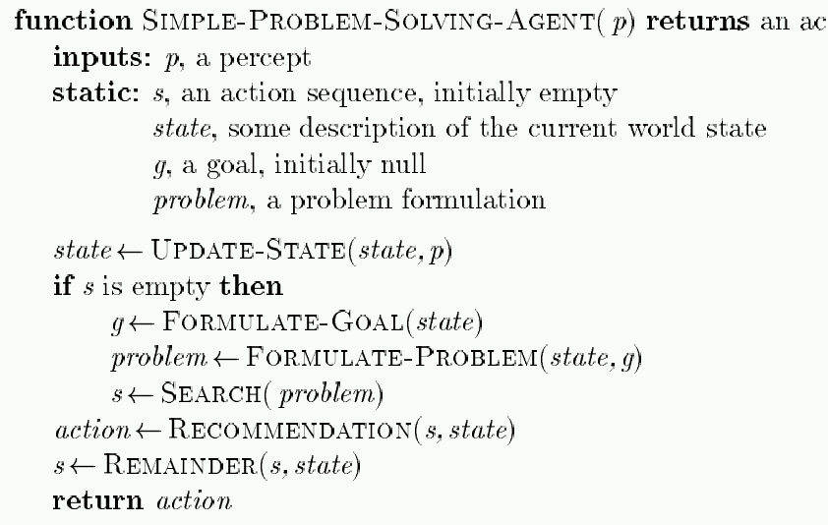
Problem-Solving Agent
tion
Note: This is offline problem-solving. Online problem-solving involves acting w/o complete knowledge of the problem and environment

Slide 21
Example: Buckets
Measure 7 liters of water using a 3 liter, a 5 liter, and a 9 liter bucket.
Formulate goal: Have 7 liters of water in 9-liter bucket
Formulate problem:
  States: amount of water in the buckets
  Operators: Fill bucket from source, empty bucket
Find solution: sequence of operators that bring you from current state to the goal state

Slide 22
Remember (lecture 2): Environment types
Environment | Accessible | Deterministic | Episodic | Static | Discrete
Operating System | Yes | Yes | No | No | Yes
Virtual Reality | Yes | Yes | Yes/No | No | Yes/No
Office Environment | No | No | No | No | No
Mars | No | Semi | No | Semi | No
The environment types largely determine the agent design.

Slide 23
Problem types
Single-state problem: deterministic, accessible
Agent knows everything about world, thus can
calculate optimal action sequence to reach goal state.
Multiple-state problem: deterministic, inaccessible
Agent must reason about sequences of actions and
states assumed while working towards goal state.
Contingency problem: nondeterministic, inaccessible
  Must use sensors during execution
  Solution is a tree or policy
  Often interleave search and execution
Exploration problem: unknown state space
Discover and learn about environment while taking actions.

Slide 24
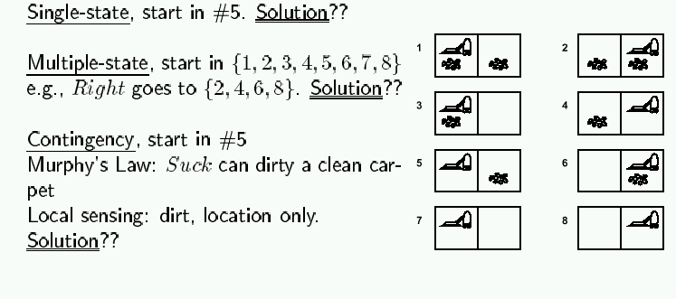
Example: Vacuum world
Simplified world: 2 locations, each may or not contain dirt,
each may or not contain vacuuming agent.
Goal of agent: clean up the dirt.

Slide 25
Example: Romania
In Romania, on vacation. Currently in Arad.
Flight leaves tomorrow from Bucharest.
Formulate goal:
be in Bucharest
Formulate problem:
states: various cities
operators: drive between cities
Find solution:
sequence of cities, such that total driving distance is minimized.

Slide 26
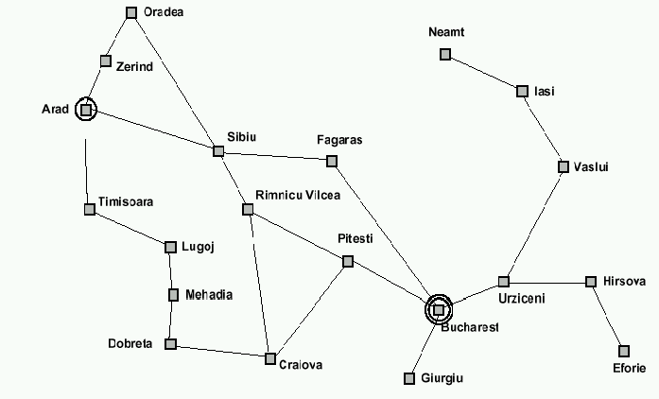
Example: Traveling from Arad To Bucharest

Slide 27
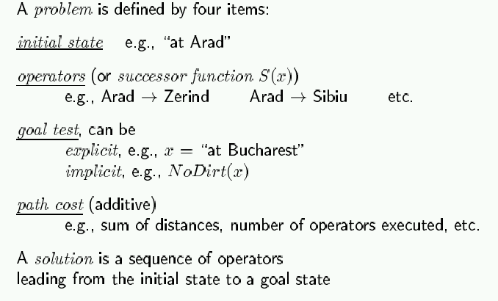
Problem formulation

Slide 28
Selecting a state space
Real world is absurdly complex; some abstraction is necessary to allow us to reason on it…
Selecting the correct abstraction and resulting state space is a difficult problem!
Abstract states ⬄ real-world states
Abstract operators ⬄ sequences or real-world actions
(e.g., going from city i to city j costs Lij ⬄ actually drive from city i to j)
Abstract solution ⬄ set of real actions to take in the
real world such as to solve problem

Slide 29
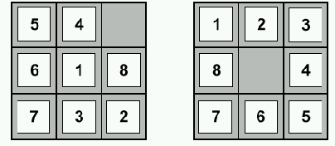
Example: 8-puzzle
start state
goal state
State:
Operators:
Goal test:
Path cost:

Slide 30
Example: 8-puzzle
start state
goal state
State: integer location of tiles (ignore intermediate locations)
Operators: moving blank left, right, up, down (ignore jamming)
Goal test: does state match goal state?
Path cost: 1 per move

Slide 31
Example: 8-puzzle
Why search algorithms?
  8-puzzle has 362,800 states
  15-puzzle has 10^12 states
  24-puzzle has 10^25 states
So, we need a principled way to look for a solution in these huge search spaces…
start state
goal state

Slide 32
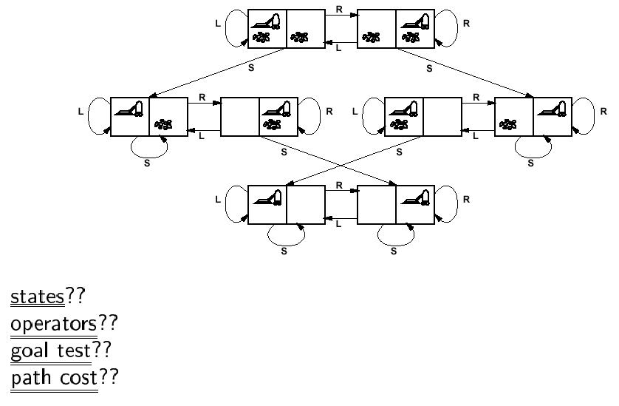
Back to Vacuum World

Slide 33
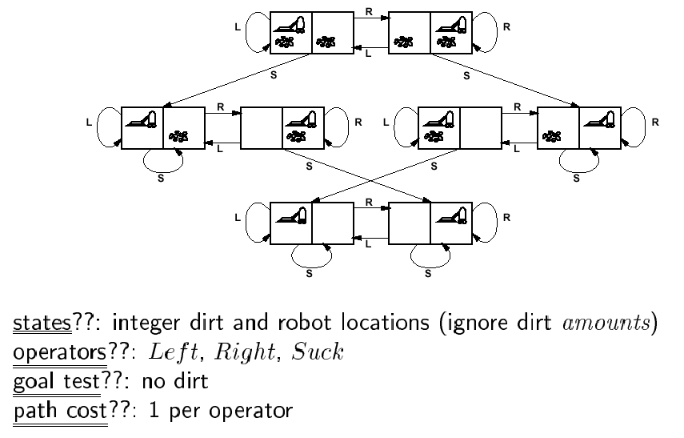
Back to Vacuum World

Slide 34
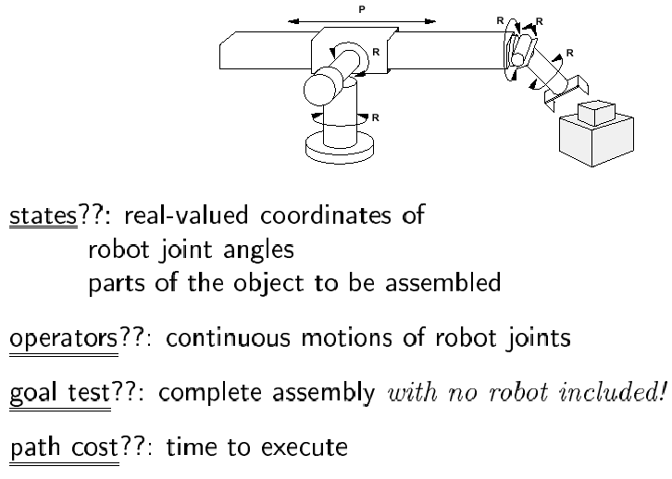
Example: Robotic Assembly

Slide 35
Real-life example: VLSI Layout
Given schematic diagram comprising components (chips, resistors, capacitors, etc) and interconnections (wires), find optimal way to place components on a printed circuit board, under the constraint that only a small number of wire layers are available (and wires on a given layer cannot cross!)
“optimal way”??
minimize surface area
minimize number of signal layers
minimize number of vias (connections from one layer to another)
minimize length of some signal lines (e.g., clock line)
distribute heat throughout board
etc.

Slide 36
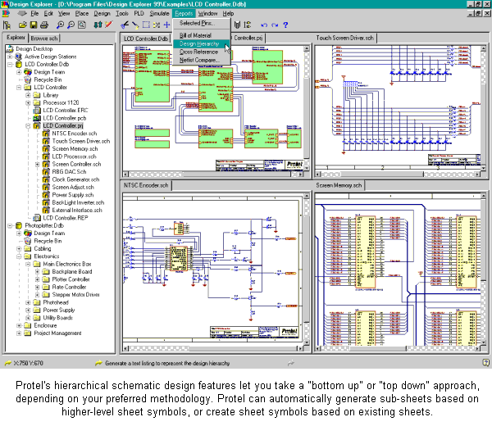
Enter schematics;
do not worry about placement & wire crossing

Slide 37
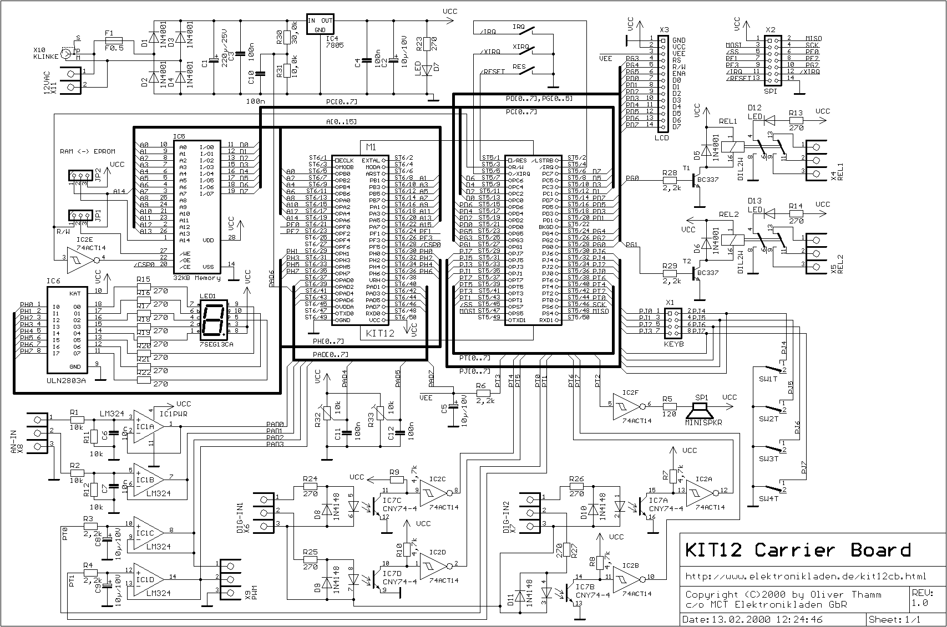

Slide 38
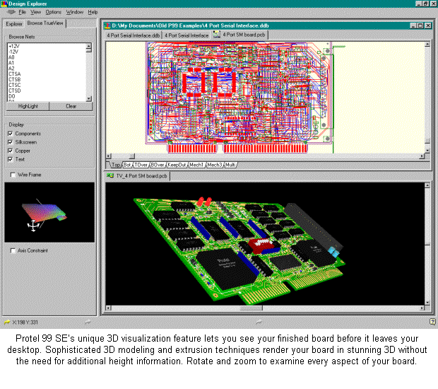
Use automated tools to place components
and route wiring.

Slide 39
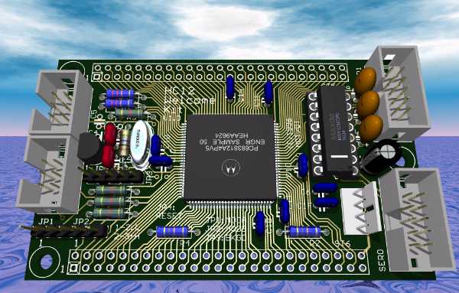

Slide 40
Search algorithms
Basic idea:
offline, systematic exploration of simulated state-space by generating successors of explored states (expanding)
Function General-Search(problem, strategy) returns a solution, or failure
initialize the search tree using the initial state problem
loop do
if there are no candidates for expansion then return failure
choose a leaf node for expansion according to strategy
if the node contains a goal state then return the corresponding solution
else expand the node and add resulting nodes to the search tree
end

Slide 41
Last time: Problem-Solving
  Problem solving:
    Goal formulation
    Problem formulation (states, operators)
    Search for solution
  Problem formulation:
    Initial state
    ?
    ?
    ?
  Problem types:
    single state: accessible and deterministic environment
    multiple state: ?
    contingency: ?
    exploration: ?

Slide 42
Last time: Problem-Solving
  Problem solving:
    Goal formulation
    Problem formulation (states, operators)
    Search for solution
  Problem formulation:
    Initial state
    Operators
    Goal test
    Path cost
  Problem types:
    single state: accessible and deterministic environment
    multiple state: ?
    contingency: ?
    exploration: ?

Slide 43
Last time: Problem-Solving
  Problem solving:
    Goal formulation
    Problem formulation (states, operators)
    Search for solution
  Problem formulation:
    Initial state
    Operators
    Goal test
    Path cost
  Problem types:
    single state: accessible and deterministic environment
    multiple state: inaccessible and deterministic environment
    contingency: inaccessible and nondeterministic environment
    exploration: unknown state-space

Slide 44
Last time: Finding a solution
Solution: is ???
Basic idea: offline, systematic exploration of simulated state-space by generating successors of explored states (expanding)
Function General-Search(problem, strategy) returns a solution, or failure
initialize the search tree using the initial state problem
loop do
if there are no candidates for expansion then return failure
choose a leaf node for expansion according to strategy
if the node contains a goal state then return the corresponding solution
else expand the node and add resulting nodes to the search tree
end

Slide 45
Last time: Finding a solution
Solution: is a sequence of operators that bring you from current state to the goal state.
Basic idea: offline, systematic exploration of simulated state-space by generating successors of explored states (expanding).
Function General-Search(problem, strategy) returns a solution, or failure
initialize the search tree using the initial state problem
loop do
if there are no candidates for expansion then return failure
choose a leaf node for expansion according to strategy
if the node contains a goal state then return the corresponding solution
else expand the node and add resulting nodes to the search tree
end
Strategy: The search strategy is determined by ???

Slide 46
Last time: Finding a solution
Solution: is a sequence of operators that bring you from current state to the goal state
Basic idea: offline, systematic exploration of simulated state-space by generating successors of explored states (expanding)
Function General-Search(problem, strategy) returns a solution, or failure
initialize the search tree using the initial state problem
loop do
if there are no candidates for expansion then return failure
choose a leaf node for expansion according to strategy
if the node contains a goal state then return the corresponding solution
else expand the node and add resulting nodes to the search tree
end
Strategy: The search strategy is determined by the order in which the nodes are expanded.

Slide 47
Example: Traveling from Arad To Bucharest

Slide 48
From problem space to search tree
3
A
4
B
4
C
Problem space
S
5
5
G
4
D
E
F
3
2
4
3
S
4
Associated
loop-free
search tree
4
A
D
5
5
2
B
D
A
E
4
5
2
4
5
4
C
E
E
B
B
F
2
4
5
4
4
5
4
4
3
D
F
B
F
C
E
A
C
G
3
4
3
4
G
C
G
F
G
3

Slide 49
Paths in search trees
Denotes:
SA
S
A
Denotes:SDA
D
B
D
A
E
C
E
E
B
B
F
D
F
B
F
C
E
A
C
G
Denotes:
SDEBA
G
C
G
F
G

Slide 50

General search example

Slide 51
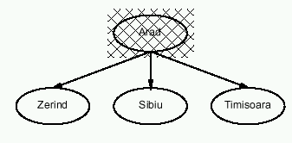
General search example

Slide 52
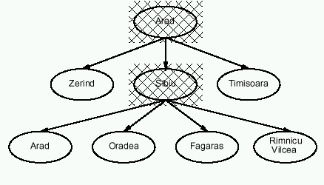
General search example

Slide 53
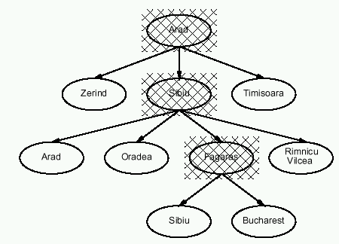
General search example

Slide 54
Implementation of search algorithms
Function General-Search(problem, Queuing-Fn) returns a solution, or failure
nodes ← make-queue(make-node(initial-state[problem]))
loop do
if nodes is empty then return failure
node ← Remove-Front(nodes)
if Goal-Test[problem] applied to State(node) succeeds then return node
nodes ← Queuing-Fn(nodes, Expand(node, Operators[problem]))
end
Queuing-Fn(queue, elements) is a queuing function that inserts a set of elements into the queue and determines the order of node expansion. Varieties of the queuing function produce varieties of the search algorithm.

Slide 55
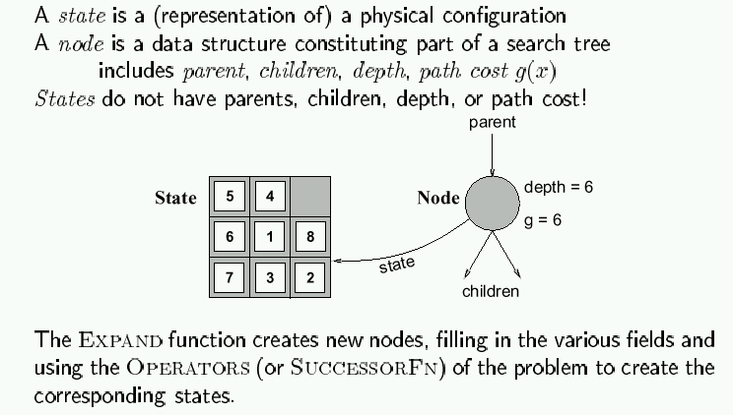
Encapsulating state information in nodes

Slide 56
Evaluation of search strategies
A search strategy is defined by picking the order of node expansion.
Search algorithms are commonly evaluated according to the following four criteria:
  Completeness: does it always find a solution if one exists?
  Time complexity: how long does it take as function of num. of nodes?
  Space complexity: how much memory does it require?
  Optimality: does it guarantee the least-cost solution?
Time and space complexity are measured in terms of:
  b – max branching factor of the search tree
  d – depth of the least-cost solution
  m – max depth of the search tree (may be infinity)

Slide 57
Complexity
Why worry about complexity of algorithms?
because a problem may be solvable in principle but may take too long to solve in practice
How can we evaluate the complexity of algorithms?
through asymptotic analysis, i.e., estimate time (or number of operations) necessary to solve an instance of size n of a problem when n tends towards infinity
See AIMA, Appendix A.

Slide 58
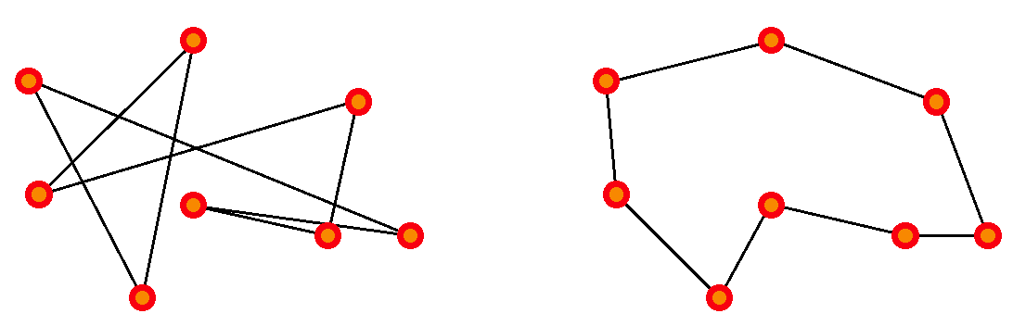
Complexity example: Traveling Salesman Problem
There are n cities, with a road of length L_{ij} joining
city i to city j.
The salesman wishes to find a way to visit all cities that
is optimal in two ways: each city is visited only once, and
the total route is as short as possible.
This is a hard problem: the only known algorithms (so far) to solve it have exponential complexity, that is, the number of operations required to solve it grows as exp(n) for n cities.

Slide 59
Why is exponential complexity “hard”?
It means that the number of operations necessary to compute the exact solution of the problem grows exponentially with the size of the problem (here, the number of cities).
exp(1) = 2.72
exp(10) = 2.20 10⁴ (daily salesman trip)
exp(100) = 2.69 10⁴³ (monthly salesman planning)
exp(500) = 1.40 10²¹⁷ (music band worldwide tour)
exp(250,000) = 10^{108,573} (fedex, postal services)
Fastest computer = 10¹² operations/second

Slide 60
So…
In general, exponential-complexity problems cannot be solved for any but the smallest instances!

Slide 61
Complexity
Polynomial-time (P) problems: we can find algorithms that will solve them in a time (=number of operations) that grows polynomially with the size of the input.
for example: sort n numbers into increasing order: poor algorithms have n^2 complexity, better ones have n log(n) complexity.
Since we did not state what the order of the polynomial is, it could be very large! Are there algorithms that require more than polynomial time?
Yes (until proof of the contrary); for some algorithms, we do not know of any polynomial-time algorithm to solve them. These are referred to as nondeterministic-polynomial-time (NP) algorithms.
for example: traveling salesman problem.
In particular, exponential-time algorithms are believed to be NP.

Slide 62
Note on NP-hard problems
The formal definition of NP problems is:
A problem is nondeterministic polynomial if there exists some algorithm that can guess a solution and then verify whether or not the guess is correct in polynomial time.
(one can also state this as these problems being solvable in polynomial time on a nondeterministic Turing machine.)
In practice, until proof of the contrary, this means that known algorithms that run on known computer architectures will take more than polynomial time to solve the problem.

Slide 63
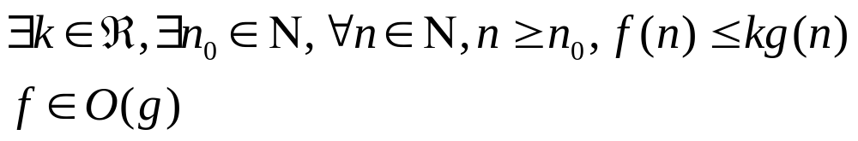
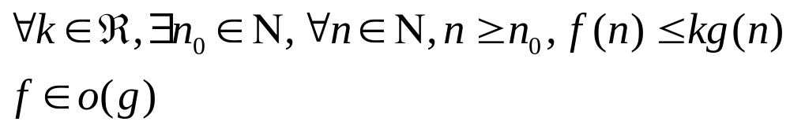
Complexity: O() and o() measures (Landau symbols)
How can we represent the complexity of an algorithm?
Given: Problem input (or instance) size: n
Number of operations to solve problem: f(n)
If, for a given function g(n), we have:
then f is dominated by g
If, for a given function g(n), we have:
then f is negligible compared to g

Slide 64
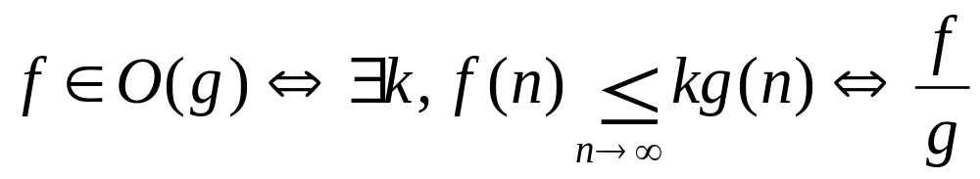
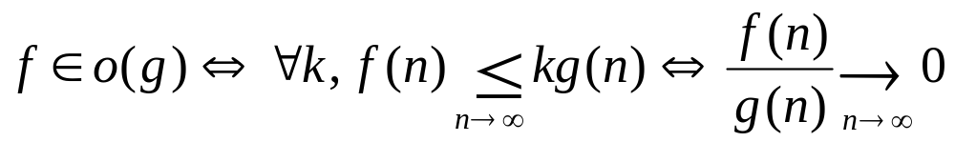
Landau symbols
is bounded

Slide 65
Examples, properties
f(n)=n, g(n)=n^2:
n is o(n^2), because n/n^2 = 1/n -> 0 as n ->infinity
similarly, log(n) is o(n)
n^C is o(exp(n)) for any C
if f is O(g), then for any K, K.f is also O(g); idem for o()
if f is O(h) and g is O(h), then for any K, L: K.f + L.g is O(h)
idem for o()
if f is O(g) and g is O(h), then f is O(h)
if f is O(g) and g is o(h), then f is o(h)
if f is o(g) and g is O(h), then f is o(h)

Slide 66
Polynomial-time hierarchy
From Handbook of Brain
Theory & Neural Networks
(Arbib, ed.;
MIT Press 1995).
NP
P
AC⁰
NC¹
NC
P complete
NP complete
PH
AC⁰: can be solved using gates of constant depth
NC¹: can be solved in logarithmic depth using 2-input gates
NC: can be solved by small, fast parallel computer
P: can be solved in polynomial time
P-complete: hardest problems in P; if one of them can be proven to be
NC, then P = NC
NP: nondeterministic-polynomial algorithms
NP-complete: hardest NP problems; if one of them can be proven to be
P, then NP = P
PH: polynomial-time hierarchy

Slide 67

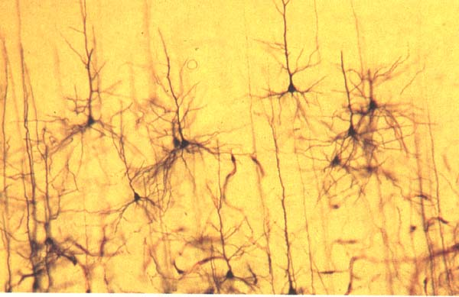
Complexity and the human brain
Are computers close to human brain power?
Current computer chip (CPU):
    10^3 inputs (pins)
    10^7 processing elements (gates)
    2 inputs per processing element (fan-in = 2)
    processing elements compute boolean logic (OR, AND, NOT, etc)
Typical human brain:
    10^7 inputs (sensors)
    10^10 processing elements (neurons)
    fan-in = 10^3
    processing elements compute complicated
    functions
Still a lot of improvement needed for computers; but
computer clusters come close!

Slide 68
Remember: Implementation of search algorithms
Function General-Search(problem, Queuing-Fn) returns a solution, or failure
nodes ← make-queue(make-node(initial-state[problem]))
loop do
if nodes is empty then return failure
node ← Remove-Front(nodes)
if Goal-Test[problem] applied to State(node) succeeds then return node
nodes ← Queuing-Fn(nodes, Expand(node, Operators[problem]))
end
Queuing-Fn(queue, elements) is a queuing function that inserts a set of elements into the queue and determines the order of node expansion. Varieties of the queuing function produce varieties of the search algorithm.

Slide 69
Encapsulating state information in nodes

Slide 70
Evaluation of search strategies
A search strategy is defined by picking the order of node expansion.
Search algorithms are commonly evaluated according to the following four criteria:
  Completeness: does it always find a solution if one exists?
  Time complexity: how long does it take as function of num. of nodes?
  Space complexity: how much memory does it require?
  Optimality: does it guarantee the least-cost solution?
Time and space complexity are measured in terms of:
  b – max branching factor of the search tree
  d – depth of the least-cost solution
  m – max depth of the search tree (may be infinity)

Slide 71
Note: Approximations
In our complexity analysis, we do not take the built-in loop-detection into account.
The results only ‘formally’ apply to the variants of our algorithms WITHOUT loop-checks.
Studying the effect of the loop-checking on the complexity is hard:
  overhead of the checking MAY or MAY NOT be compensated by the reduction of the size of the tree.
Also: our analysis DOES NOT take the length (space) of representing paths into account !!

Slide 72
Uninformed search strategies
Use only information available in the problem formulation
Breadth-first
Uniform-cost
Depth-first
Depth-limited
Iterative deepening

Slide 73
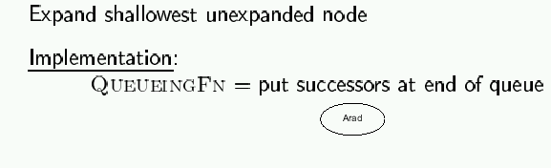
Breadth-first search

Slide 74
Example: Traveling from Arad To Bucharest

Slide 75
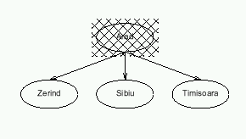
Breadth-first search

Slide 76
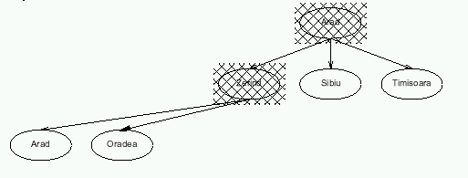
Breadth-first search

Slide 77
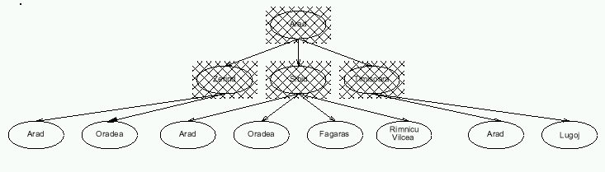
Breadth-first search

Slide 78
Properties of breadth-first search
Completeness:
Time complexity:
Space complexity:
Optimality:
Search algorithms are commonly evaluated according to the following four criteria:
  Completeness: does it always find a solution if one exists?
  Time complexity: how long does it take as function of num. of nodes?
  Space complexity: how much memory does it require?
  Optimality: does it guarantee the least-cost solution?
Time and space complexity are measured in terms of:
  b – max branching factor of the search tree
  d – depth of the least-cost solution
  m – max depth of the search tree (may be infinity)

Slide 79
Properties of breadth-first search
Completeness: Yes, if b is finite
Time complexity: 1+b+b²+…+b^{d} = O(b ^{d}), i.e., exponential in d
Space complexity: O(b ^{d}), keeps every node in memory
Optimality: Yes (assuming cost = 1 per step)
Why keep every node in memory? To avoid revisiting already-visited nodes, which may easily yield infinite loops.

Slide 80
Time complexity of breadth-first search
If a goal node is found on depth d of the tree, all nodes up till that depth are created.
d
m
b
G
Thus: O(b^{d})

Slide 81
Space complexity of breadth-first
Largest number of nodes in QUEUE is reached on the level d of the goal node.
d
m
b
G
QUEUE contains all and nodes. (Thus: 4) .
In General: b^{d}
G

Slide 82
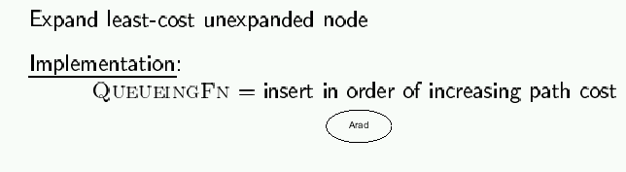
Uniform-cost search
So, the queuing function keeps the node list sorted by increasing path cost, and we expand the first unexpanded node (hence with smallest path cost)
A refinement of the breadth-first strategy:
Breadth-first = uniform-cost with path cost = node depth

Slide 83
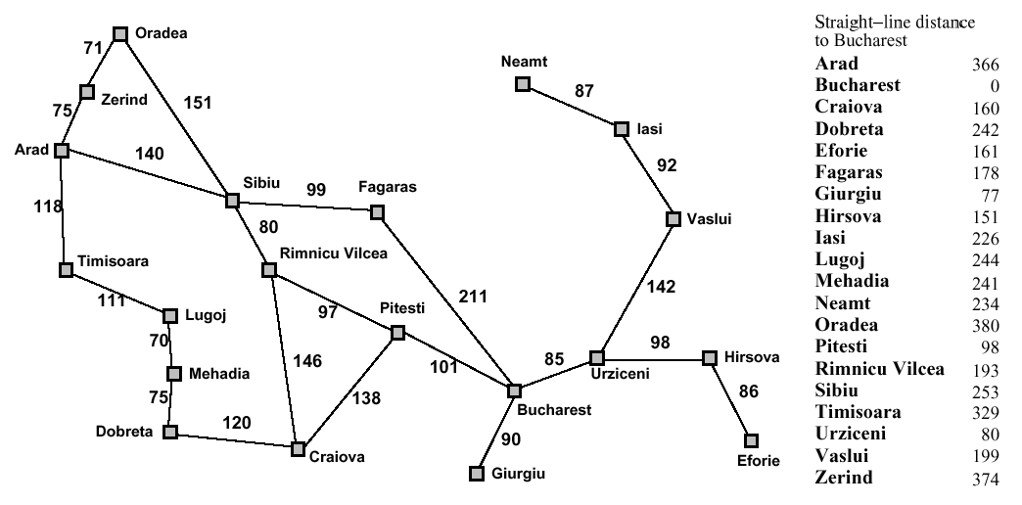
Romania with step costs in km

Slide 84
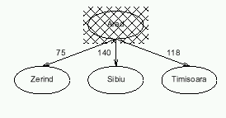
Uniform-cost search

Slide 85
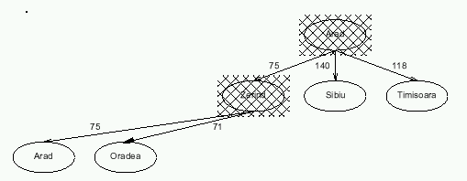
Uniform-cost search

Slide 86
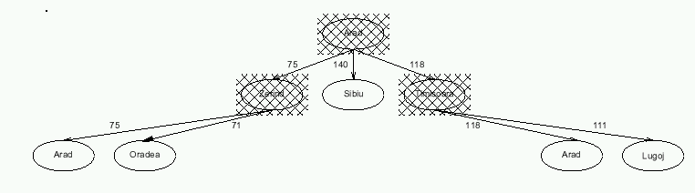
Uniform-cost search

Slide 87
Properties of uniform-cost search
Completeness: Yes, if step cost ≥ ε >0
Time complexity: # nodes with g ≤ cost of optimal solution, ≤ O(b ^{d})
Space complexity: # nodes with g ≤ cost of optimal solution, ≤ O(b ^{d})
Optimality: Yes, as long as path cost never decreases
g(n) is the path cost to node n
Remember:
b = branching factor
d = depth of least-cost solution

Slide 88
Implementation of uniform-cost search
Initialize Queue with root node (built from start state)
Repeat until (Queue is empty) or (first node has Goal state):
  Remove first node from front of Queue
  Expand node (find its children)
  Reject those children that have already been considered, to avoid loops
  Add remaining children to Queue, in a way that keeps entire queue sorted by increasing path cost
If Goal was reached, return success, otherwise failure

Slide 89
Caution!
Uniform-cost search not optimal if it is terminated when any node in the queue has goal state.
1
S
1
5
A
5
1
C
2
B
5
Uniform cost returns the path with cost 102 (if any goal node is considered a solution), while there is a path with cost 25.
D
10
5
100
E
15
5
F
20
G
5

Slide 90
Note: Loop Detection
In class, we saw that the search may fail or be sub-optimal if:
- no loop detection: then algorithm runs into infinite cycles
(A -> B -> A -> B -> …)
- not queuing-up a node that has a state which we have
already visited: may yield suboptimal solution
- simply avoiding to go back to our parent: looks promising,
but we have not proven that it works
Solution? do not enqueue a node if its state matches the state of any of its parents (assuming path costs>0).
Indeed, if path costs > 0, it will always cost us more to consider a node with that state again than it had already cost us the first time.
Is that enough??

Slide 91
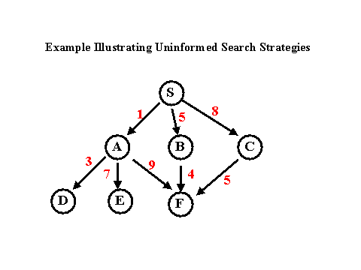
Example
G

Slide 92
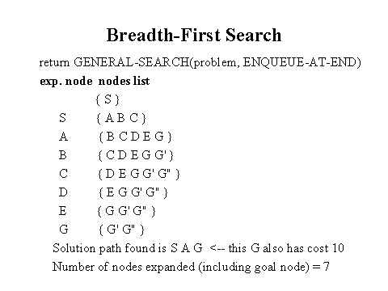
Breadth-First Search Solution

Slide 93
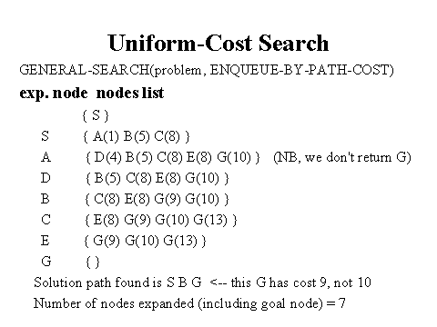
Uniform-Cost Search Solution

Slide 94
Note: Queuing in Uniform-Cost Search
In the previous example, it is wasteful (but not incorrect) to queue-up three nodes with G state, if our goal if to find the least-cost solution:
Although they represent different paths, we know for sure that the one with smallest path cost (9 in the example) will yield a solution with smaller total path cost than the others.
So we can refine the queuing function by:
- queue-up node if
1) its state does not match the state of any parent
and 2) path cost smaller than path cost of any
unexpanded node with same state in the queue (and in this case, replace old node with same
state by our new node)
Is that it??

Slide 95
A Clean Robust Algorithm
Function UniformCost-Search(problem, Queuing-Fn) returns a solution, or failure
open ← make-queue(make-node(initial-state[problem]))
closed ← [empty]
loop do
if open is empty then return failure
currnode ← Remove-Front(open)
if Goal-Test[problem] applied to State(currnode) then return currnode
children ← Expand(currnode, Operators[problem])
while children not empty
[… see next slide …]
end
closed ← Insert(closed, currnode)
open ← Sort-By-PathCost(open)
end

Slide 96
A Clean Robust Algorithm
[… see previous slide …]
children ← Expand(currnode, Operators[problem])
while children not empty
child ← Remove-Front(children)
if no node in open or closed has child’s state
open ← Queuing-Fn(open, child)
else if there exists node in open that has child’s state
if PathCost(child) < PathCost(node)
open ← Delete-Node(open, node)
open ← Queuing-Fn(open, child)
else if there exists node in closed that has child’s state
if PathCost(child) < PathCost(node)
closed ← Delete-Node(closed, node)
open ← Queuing-Fn(open, child)
end
[… see previous slide …]

Slide 97
Example
S
# State Depth Cost Parent
1 S 0 0 -
1
5
A
1
C
B
5
1
D
5
100
E
F
5
G
5

Slide 98
Example
S
# State Depth Cost Parent
1 S 0 0 -
2 A 1 1 1
3 C 1 5 1
1
5
A
1
C
B
5
1
D
5
100
E
Black = open queue
Grey = closed queue
F
5
Insert expanded nodes
Such as to keep open queue
sorted
G
5

Slide 99
Example
S
# State Depth Cost Parent
1 S 0 0 -
2 A 1 1 1
4 B 2 2 2
3 C 1 5 1
1
5
A
1
C
B
5
1
D
5
E
Node 2 has 2 successors: one with state B
and one with state S.
We have node #1 in closed with state S;
but its path cost 0 is smaller than the path
cost obtained by expanding from A to S.
So we do not queue-up the successor of
node 2 that has state S.
100
F
5
G
5

Slide 100
Example
S
# State Depth Cost Parent
1 S 0 0 -
2 A 1 1 1
4 B 2 2 2
5 C 3 3 4
6 G 3 102 4
1
5
A
1
C
B
5
1
D
5
E
Node 4 has a successor with state C and
Cost smaller than node #3 in open that
Also had state C; so we update open
To reflect the shortest path.
100
F
5
G
5

Slide 101
Example
S
# State Depth Cost Parent
1 S 0 0 -
2 A 1 1 1
4 B 2 2 2
5 C 3 3 4
7 D 4 8 5
6 G 3 102 4
1
5
A
1
C
B
5
1
D
5
100
E
F
5
G
5

Slide 102
Example
S
# State Depth Cost Parent
1 S 0 0 -
2 A 1 1 1
4 B 2 2 2
5 C 3 3 4
7 D 4 8 5
8 E 5 13 7
6 G 3 102 4
1
5
A
1
C
B
5
1
D
5
100
E
F
5
G
5

Slide 103
Example
S
# State Depth Cost Parent
1 S 0 0 -
2 A 1 1 1
4 B 2 2 2
5 C 3 3 4
7 D 4 8 5
8 E 5 13 7
9 F 6 18 8
6 G 3 102 4
1
5
A
1
C
B
5
1
D
5
100
E
F
5
G
5

Slide 104
Example
S
# State Depth Cost Parent
1 S 0 0 -
2 A 1 1 1
4 B 2 2 2
5 C 3 3 4
7 D 4 8 5
8 E 5 13 7
9 F 6 18 8
10 G 7 23 9
6 G 3 102 4
1
5
A
1
C
B
5
1
D
5
100
E
F
5
G
5

Slide 105
Example
S
# State Depth Cost Parent
1 S 0 0 -
2 A 1 1 1
4 B 2 2 2
5 C 3 3 4
7 D 4 8 5
8 E 5 13 7
9 F 6 18 8
10 G 7 23 9
6 G 3 102 4
1
5
A
1
C
B
5
1
D
5
100
E
F
5
G
5
Goal reached

Slide 106
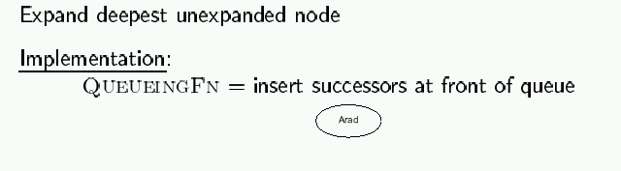
Depth-first search

Slide 107
Romania with step costs in km

Slide 108
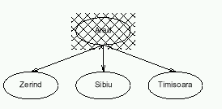
Depth-first search

Slide 109
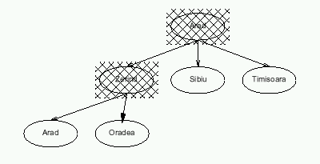
Depth-first search

Slide 110
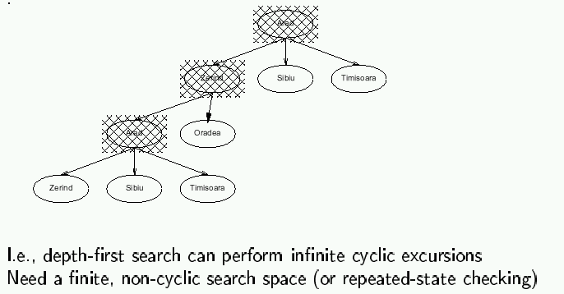
Depth-first search

Slide 111
Properties of depth-first search
Completeness: No, fails in infinite state-space (yes if finite state space)
Time complexity: O(b ^{m})
Space complexity: O(bm)
Optimality: No
Remember:
b = branching factor
m = max depth of search tree

Slide 112
Time complexity of depth-first: details
In the worst case:
  the (only) goal node may be on the right-most branch,
m
b
G
Time complexity == b^{m} + b^{m-1} + … + 1 = b^{m+1} -1
Thus: O(b^{m})
b - 1

Slide 113
Space complexity of depth-first
Largest number of nodes in QUEUE is reached in bottom left-most node.
Example: m = 3, b = 3 :
...
QUEUE contains all nodes. Thus: 7.
In General: ((b-1) * m) + 1
Order: O(m*b)

Slide 114
Avoiding repeated states
In increasing order of effectiveness and computational overhead:
do not return to state we come from, i.e., expand function will skip possible successors that are in same state as node’s parent.
do not create paths with cycles, i.e., expand function will skip possible successors that are in same state as any of node’s ancestors.
do not generate any state that was ever generated before, by keeping track (in memory) of every state generated, unless the cost of reaching that state is lower than last time we reached it.

Slide 115
Depth-limited search
Is a depth-first search with depth limit l
Implementation:
Nodes at depth l have no successors.
Complete: if cutoff chosen appropriately then it is guaranteed to find a solution.
Optimal: it does not guarantee to find the least-cost solution

Slide 116
Iterative deepening search
Function Iterative-deepening-Search(problem) returns a solution, or failure
for depth = 0 to ∞ do
result ← Depth-Limited-Search(problem, depth)
if result succeeds then return result
end
return failure
Combines the best of breadth-first and depth-first search strategies.
Completeness: Yes,
Time complexity: O(b ^{d})
Space complexity: O(bd)
Optimality: Yes, if step cost = 1

Slide 117
Romania with step costs in km

Slide 118
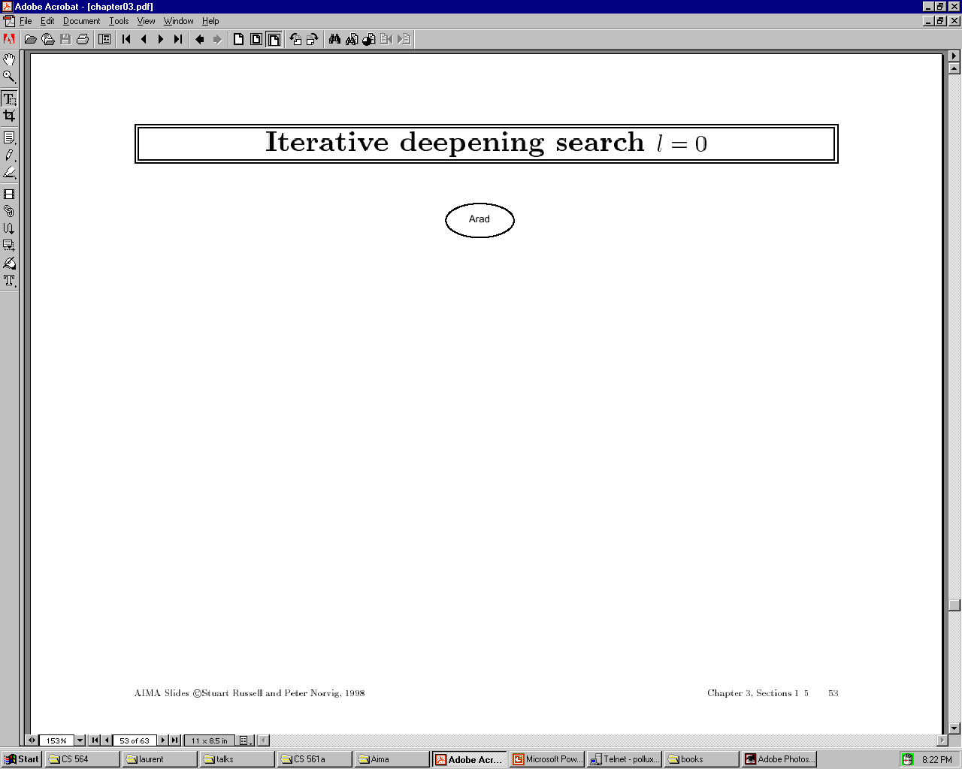

Slide 119


Slide 120
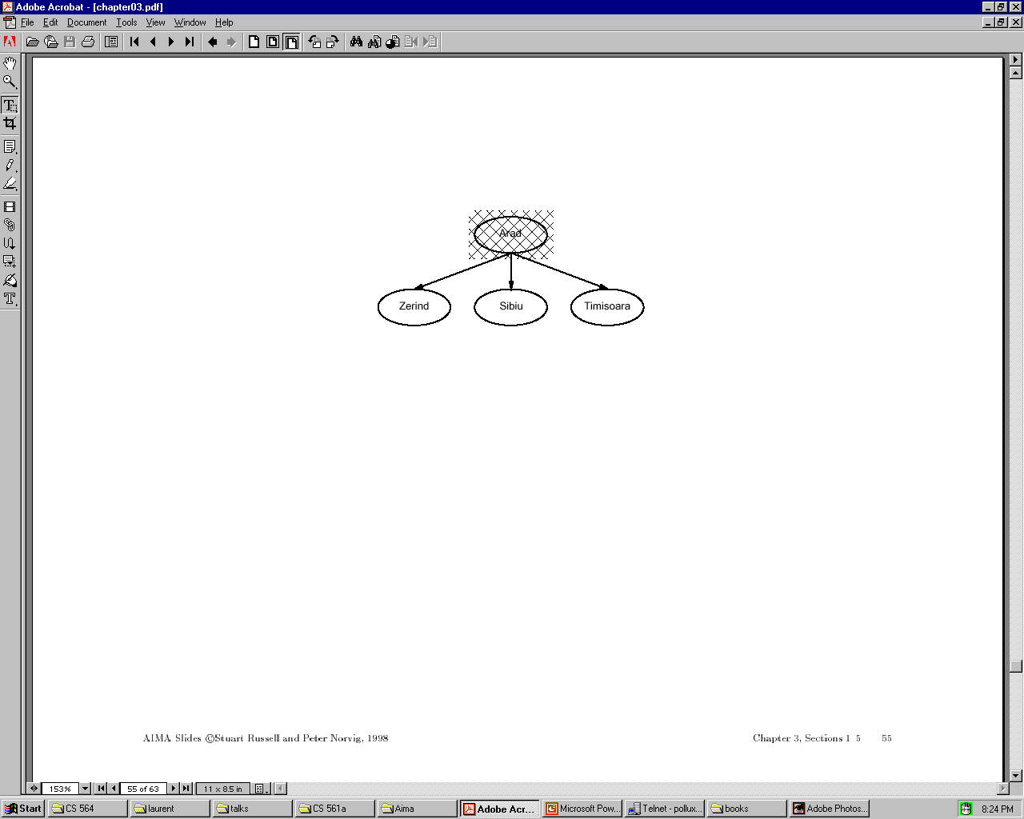

Slide 121


Slide 122


Slide 123
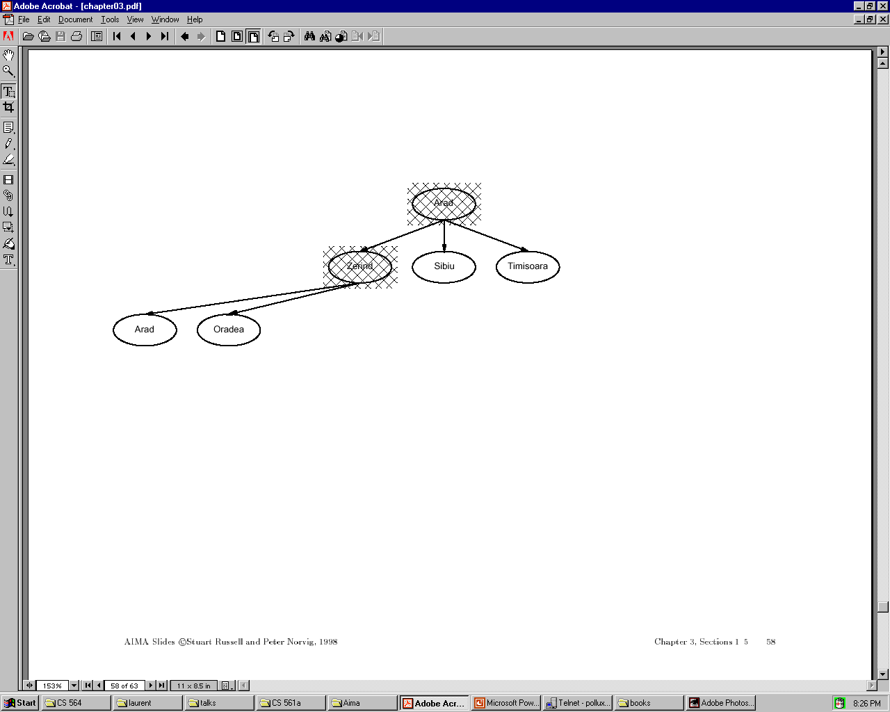

Slide 124
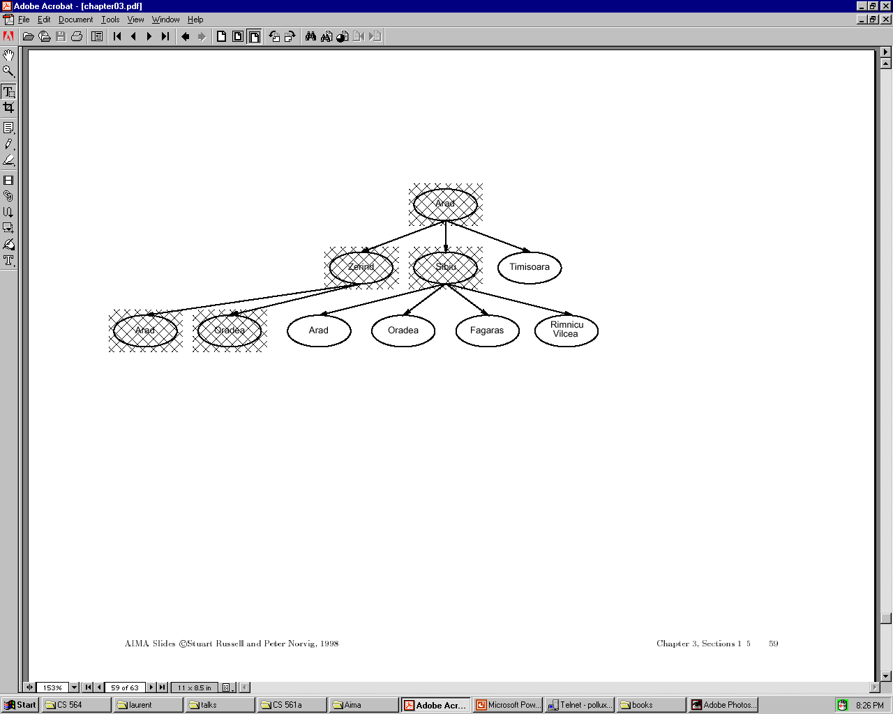

Slide 125
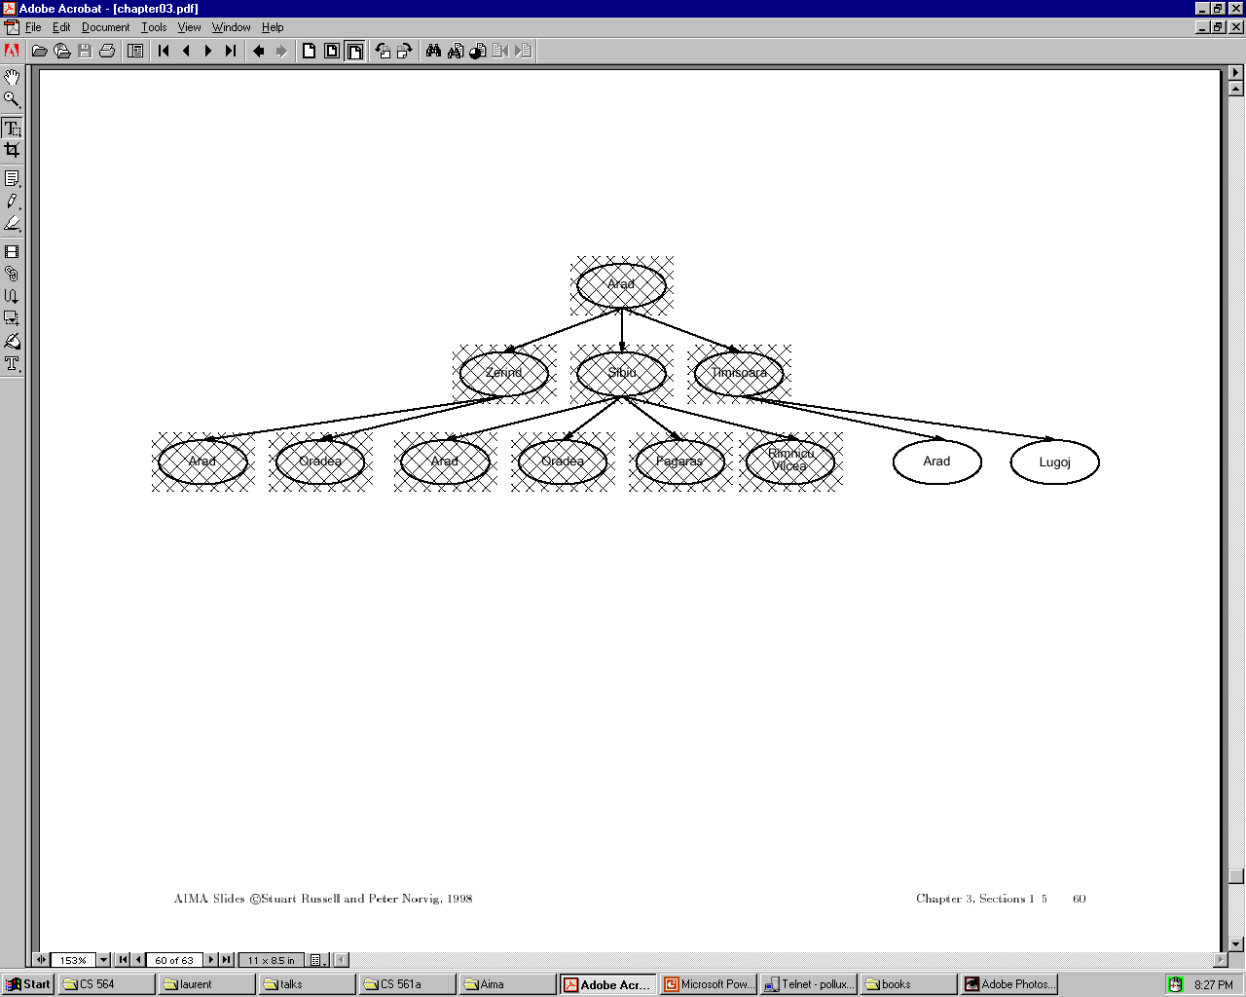

Slide 126
Iterative deepening complexity
Iterative deepening search may seem wasteful because so many states are expanded multiple times.
In practice, however, the overhead of these multiple expansions is small, because most of the nodes are towards leaves (bottom) of the search tree:
thus, the nodes that are evaluated several times (towards top of tree) are in relatively small number.
In iterative deepening, nodes at bottom level are expanded once, level above twice, etc. up to root (expanded d+1 times) so total number of expansions is:
(d+1)1 + (d)b + (d-1)b^2 + … + 3b^(d-2) + 2b^(d-1) + 1b^d = O(b^d)
In general, iterative deepening is preferred to depth-first or breadth-first when search space large and depth of solution not known.

Slide 127
Bidirectional search
Both search forward from initial state, and backwards from goal.
Stop when the two searches meet in the middle.
Problem: how do we search backwards from goal??
  predecessor of node n = all nodes that have n as successor
  this may not always be easy to compute!
  if several goal states, apply predecessor function to them just as we applied successor (only works well if goals are explicitly known; may be difficult if goals only characterized implicitly).
  for bidirectional search to work well, there must be an efficient way to check whether a given node belongs to the other search tree.
  select a given search
  algorithm for each half.
Start
Goal

Slide 128
Comparing uninformed search strategies
Criterion Breadth- Uniform Depth- Depth- Iterative Bidirectional
first cost first limited deepening (if applicable)
Time b^d b^d b^m b^l b^d b^(d/2)
Space b^d b^d bm bl bd b^(d/2)
Optimal? Yes Yes No No Yes Yes
Complete? Yes Yes No Yes if l≥d Yes Yes
  b – max branching factor of the search tree
  d – depth of the least-cost solution
  m – max depth of the state-space (may be infinity)
  l – depth cutoff

Slide 129
Summary
Problem formulation usually requires abstracting away real-world details to define a state space that can be explored using computer algorithms.
Once problem is formulated in abstract form, complexity analysis helps us picking out best algorithm to solve problem.
Variety of uninformed search strategies; difference lies in method used to pick node that will be further expanded.
Iterative deepening search only uses linear space and not much more time than other uniformed search strategies.

